Slide 1
TRAINING FOR TEXAS VOLUNTEER DEPUTY REGISTRARS

Slide 2
TABLE OF CONTENTS
BEFORE GETTING STARTED
QUALIFICATIONS
LENGTH OF APPOINTMENT
ROLE OF A VOLUNTEER DEPUTY REGISTRAR
Supplies Needed
Distributing and Accepting Applications
Assisting Applicants
Reviewing the Applications
Registration Receipt
Delivery of Applications and Receipts
VOTER REGISTRATION
Applicant Eligibility Requirements
Voter Name Changes
Voter Address Changes
Effective Date of Registration
Period of Effectiveness
UPCOMING ELECTIONS

Slide 3
BEFORE GETTING STARTED

Slide 4
BEFORE GETTING STARTED
A person may not receive another person’s registration application until satisfactorily completing training developed or approved by the Secretary of State and is appointed a volunteer deputy registrar.

Slide 5
BEFORE GETTING STARTED
At the time of appointment, the county voter registrar will advise the volunteer deputy registrar of any county-specific procedures for processing voter applications and that the only requirements for voter registration are those prescribed by state law or by the Secretary of State.

Slide 6
QUALIFICATIONS for Volunteer Deputy Registrars

Slide 7
QUALIFICATIONS
A Volunteer Deputy Registrar must:
be 18 years of age or older
be a United States Citizen
not have been determined by a final judgment of a court exercising probate jurisdiction to be:
totally mentally incapacitated, or
partially mentally incapacitated without the right to vote
never have been convicted of failing to deliver a voter registration application to a voter registrar
not have been finally convicted of a felony, or, if convicted, must have
fully discharged the sentence, including any term of incarceration, parole, or supervision, or
been pardoned or otherwise released from the resulting disability to vote

Slide 8
QUALIFICATIONS
A Volunteer Deputy Registrar must:
not have been finally convicted of identity theft under Section 32.51 of the Texas Penal Code
be a Texas resident
NOTE: A county voter registrar may not reappoint a person whose appointment as a volunteer deputy registrar is terminated either for a final conviction under (1) Section 13.043, Texas Election Code, relating to delivery of completed registration applications or (2) Section 13.008, Texas Election Code, relating to performance-based compensation for volunteer deputy registrars.

Slide 9
QUALIFICATIONS
NOTE: Pursuant to Section 13.031(d)(3) of the Texas Election Code, to be eligible for appointment as a volunteer deputy registrar, a person must meet the requirements to be a qualified voter under Section 11.002 of the Code, except that the person is NOT required to be a registered voter.

Slide 10
LENGTH OF APPOINTMENT

Slide 11
LENGTH OF APPOINTMENT
A person who meets the qualifications may be appointed a volunteer deputy registrar at any time.
All appointments expire on December 31st of every even-numbered year.
A person who has previously taken the volunteer deputy registrar examination and received a certificate of appointment in one county is not required to take the examination again in another county. The person should submit a Request for Appointment as a VDR with the new county. The voter registrar in the new county will appoint the person as a VDR and advise of any county-specific procedures.

Slide 12
LENGTH OF APPOINTMENT
Your appointment as a volunteer deputy registrar MAY be terminated by the appointing authority if it is determined that you:
failed to properly review a voter registration application;
intentionally destroyed or physically altered a registration application; or
engaged in any other activity that conflicts with your responsibilities as a volunteer deputy registrar.

Slide 13
LENGTH OF APPOINTMENT
Your appointment as a volunteer deputy registrar WILL be terminated by the county voter registrar if you are:
finally convicted of an offense under the law relating to performance-based compensation for voter registration, Section 13.008, Texas Election Code; or
finally convicted of an offense under the law relating to a failure to deliver a completed voter registration application to the county voter registrar, Section 13.043, Texas Election Code.

Slide 14
ROLE OF A VOLUNTEER DEPUTY REGISTRAR

Slide 15
SUPPLIES NEEDED
Certificate of Appointment*
Texas Volunteer Deputy Registrar Guide and any other handbook provided by your appointing authority*
Voter Registration Applications*
Receipt Book*
Pens
*All election materials issued to a volunteer deputy registrar, (including the Certificate of Appointment, receipt books, receipts, applications and other forms in the volunteer deputy registrar’s possession) must be returned or accounted for upon termination of appointment, not later than the second day after the volunteer deputy registrar receives the termination notice.

Slide 16
Distributing and Accepting Applications

Slide 17
DISTRIBUTING & ACCEPTING APPLICATIONS
A volunteer deputy registrar assists the county voter registrar who appointed him or her to encourage voter registration. A volunteer deputy registrar:
may distribute voter registration applications to anyone who requests one.
may distribute AND ACCEPT a completed voter registration application from any resident of the county who is:
a United State citizen;
a resident of the county;
at least 17 years and 10 months of age;
not a convicted felon (unless the person’s sentence has been completed, including probation or parole or the person has been pardoned or otherwise released from the resulting disability to vote);
not a person determined by a final judgment of a court exercising probate jurisdiction to be (1) totally mentally incapacitated; or (2) partially mentally incapacitated without the right to vote.
may distribute AND ACCEPT a completed voter registration application from any resident of the county who wishes to change or correct information on his/her voter registration certificate (such as name or address).

Slide 18
DISTRIBUTING & ACCEPTING APPLICATIONS
Your county voter registrar should provide you with applications containing the county return address. If your county voter registrar does not have enough applications to provide to you, you may print blank applications for volunteer deputy registrars from the Secretary of State’s website. These applications should only be distributed to applicants residing in the county. Should you receive generic applications containing the secretary of state’s return address, you can distribute to anyone residing in any county; however, you can only accept applications from those registering within the county in which you were appointed.

Slide 19
Assisting Applicants

Slide 20
ASSISTING APPLICANTS
You may assist any resident of the county in completing a voter registration application, if he/she cannot read, or has a physical disability.
If an applicant cannot sign his/her name on the application, the applicant may make a mark on the signature line. Print the name of the applicant beside the mark. Sign your name and address as the witness and state the reason the applicant is unable to sign.
You may allow another registered voter (or anyone who has submitted a registration application) to fill out and sign an application for his/her spouse, parent or child. That person must sign the application as "agent" and state the relationship to the applicant on the application. The "agent" must have the permission of the applicant to do this.

Slide 21
Reviewing the Applications

Slide 22
REVIEWING THE APPLICATIONS
Each voter registration application should be reviewed in the presence of the applicant.
If the voter registration application does not contain all the required information, including the required signature, the volunteer deputy registrar shall return the application to the applicant for completion and resubmission.

Slide 23
REVIEWING THE APPLICATIONS
A voter registration application you accept from any resident of the county should include the following:
Section 1: Applicant must select why they are submitting the application (new application, change to current information or request for replacement). Applicant must also answer citizenship and age question;
Section 2: Full name, including any middle, maiden, or former name;
Section 3: Residence address must be a street address or a description of the location of the residence;
Section 4: Valid mailing address, if mail can't be delivered to the residence address;
Section 5: City and County of Former Residence in Texas;
Section 6: Date of birth, including month, day, and year;
Section 9: Texas Driver’s License No., Texas Personal I.D. No. or last 4 digits of social security number. If the applicant hasn’t been issued any of these items, he or she must check the box in this section affirming this statement; and
Section 10: Signature of applicant and date of signing. Be sure the applicant has read the statements that he/she is signing regarding qualifications to register and if an agent is registering for an applicant, be sure the agent provides his/her relationship to the applicant.

Slide 24
REVIEWING THE APPLICATIONS
A volunteer deputy registrar MAY NOT:
determine if the applicant is actually qualified to register to vote; or
make the applicant provide his/her gender or telephone number.

Slide 25
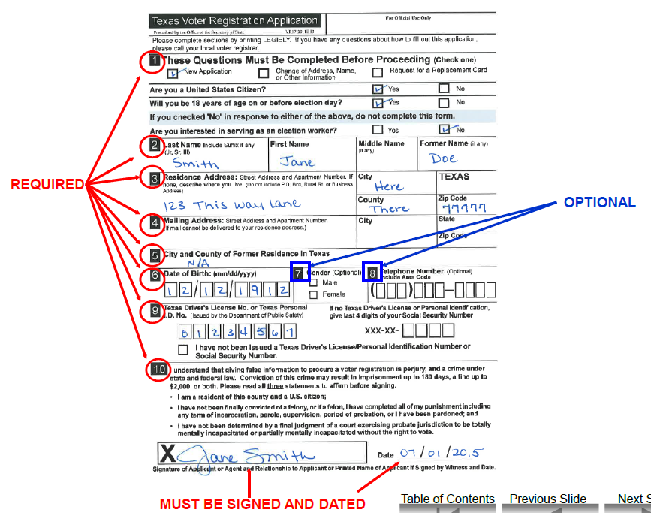
REVIEWING THE APPLICATIONS

Slide 26
Registration Receipt

Slide 27
REGISTRATION RECEIPT
For each completed voter registration application you receive, you must:
prepare a receipt in duplicate
sign the receipt and give the original to the applicant

Slide 28
REGISTRATION RECEIPT
You should not keep copies of the completed voter registration applications because these documents contain information that is confidential by law.

Slide 29
Delivery of Applications and Receipts

Slide 30
DELIVERY OF APPLICATIONS & RECEIPTS
You must deliver completed registration applications and receipts in person to the county voter registrar who appointed you no later than 5 p.m. on the 5th day after the date you receive them.
Alternatively, you may deliver completed registration applications and receipts to the county voter registrar through another volunteer deputy registrar appointed by the county voter registrar no later than 5:00 p.m. on the 5th day after the date you receive them.
You MAY NOT deliver the application and receipts by mail.

Slide 31
DELIVERY OF APPLICATIONS & RECEIPTS
NOTE: To be eligible to vote, a person must be registered 30 days before Election Day. Pursuant to Section 13.042(c) of the Election Code, as amended by House Bill 2324 (85thLegislature, RS, 2017), effective September 1, 2017, when you receive a completed application after the 34th day before the date of an election and on or before the last day for a person to timely submit a registration application for that election as provided by Section 13.143 of the Code, you MUST deliver the application to the county voter registrar no later than 5 p.m. of the next regular business day after the date to timely submit a registration application for that election as provided by Section 13.143 of the Code.

Slide 32
DELIVERY OF APPLICATIONS & RECEIPTS
FAILURE TO DELIVER AN APPLICATION IN A TIMELY MANNER IS A CRIMINAL OFFENSE.

Slide 33
VOTER REGISTRATION (INFORMATION THAT APPLICANTS MAY WISH TO KNOW)

Slide 34
Applicant Eligibility Requirements

Slide 35
APPLICANT ELIGIBILITY REQUIREMENTS
To be eligible to register to vote a person must:
be at least 17 years and 10 months of age;
be a United States citizen;
be a resident of the county where registering;
not have been determined by a final judgment of a court exercising probate jurisdiction to be
(1) totally mentally incapacitated; or
(2) partially mentally incapacitated without the right to vote
not have been finally convicted of a felony or, if so convicted, must have:
(1) fully discharged the person’s sentence, including any incarceration, parole, or supervision, or completed a period of probation ordered by any court; or
(2) been pardoned or otherwise released from the resulting disability to vote

Slide 36
Voter Name Changes

Slide 37
VOTER NAME CHANGES
If a voter’s name changes, his/her voter registration can be updated by:
making the change on the back of his/her voter registration certificate and mailing it to the county voter registrar;
submitting a new application form to the voter registrar and checking the box for "change"; or
writing a letter to the voter registrar explaining the name change.

Slide 38
Voter Address Changes

Slide 39
VOTER ADDRESS CHANGES
If the voter moves within the same county, his/her voter registration can be updated by:
making the change on the back of the voter registration certificate and mailing it to the county voter registrar;
submitting a new application form to the voter registrar and checking the box for "change";
writing a letter to the voter registrar explaining the change of address; or
submitting a change of name/address online at www.Texas.gov.
If the voter moves to another county, they must re-register in the new county of residence.

Slide 40
Effective Date of Registration

Slide 41
EFFECTIVE DATE OF REGISTRATION
The applicant can vote as soon as the 30th day after submitting the application. This 30-day waiting period starts when the volunteer deputy registrar receives the application form.
If the applicant is under 18, the registration will become effective on the 30th day after the voter registrar gets the application or on the applicant's 18th birthday, whichever comes later.

Slide 42
Period of Effectiveness

Slide 43
PERIOD OF EFFECTIVENESS
Voter registration will be automatically renewed every even-numbered year unless:
the voter moves to another address; or
the voter is convicted of a felony and has not completed the sentence, probation or parole or been otherwise pardoned or released from the resulting disability to vote.

Slide 44
UPCOMING ELECTIONS

Slide 45
ELECTIONS DIVISION
P.O. Box 12060
Austin, Texas 78711-2060
512.463.5650 or
1.800.252.VOTE (8683)
Fax 512.475.2811
TTY 7.1.1
www.sos.state.tx.us
www.votetexas.gov
elections@sos.texas.gov
Thank you for your service as a
Texas Volunteer Deputy Registrar!

